Slide 1
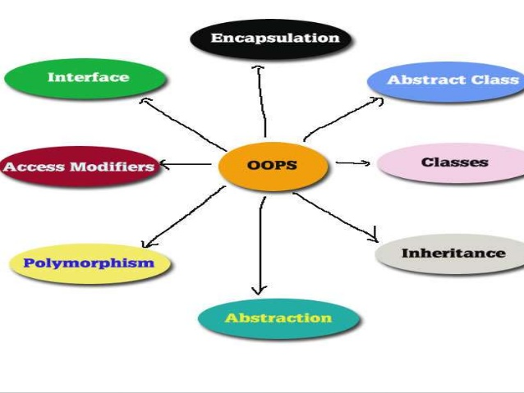
Object Oriented Programming & Design
Session – 5: 28-Oct-2018
Notes:
NOTE:
To change the image on this slide, select the picture and delete it. Then click the Pictures icon in the placeholder to insert your own image.

Slide 2

Agenda
Inheritance
  What is Inheritance
  Types of Inheritance
  Sub & Super Classes
  Accessing Inherited members
  Hiding Fields
Accessibility & Overriding
Final Classes
Abstract Classes

Slide 3
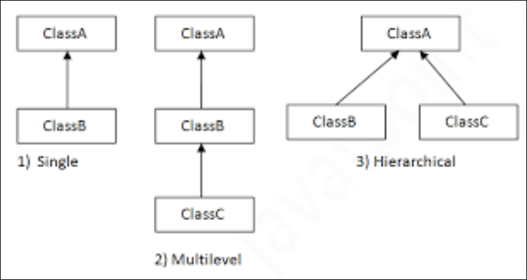
Inheritance
The easiest way of getting rich in OOP

Slide 4
Inheritance
The process by which one class acquires the properties(data members) and functionalities(methods) of another class is called inheritance.
The aim of inheritance is to provide the reusability of code so that a class has to write only the unique features and rest of the common properties and functionalities can be extended from the another class.
Child Class:
The class that extends the features of another class is known as child class, sub class or derived class.
Parent Class:
The class whose properties and functionalities are used(inherited) by another class is known as parent class, super class or Base class.
Inheritance is a process of defining a new class based on an existing class by extending its common data members and methods. Inheritance allows us to reuse of code, it improves reusability in your java application.
Note: The biggest advantage of Inheritance is that the code that is already present in base class need not be rewritten in the child class.

Slide 5
Inheritance
Let us see an Example =- Employee Class . To avoid such problems as discussed in the program Inheritance is best used.
The common features of employees appear in a parent class. Each different type of employee is represented by a child class.
When a new type of employee such as a contractor comes along, a new child class is written that extends the parent class. None of the existing code needs to be touched.

Slide 6
Inheritance – When to Use it
The is a relationship is a simple but powerful rule for testing if your inheritance is a good design. Whenever you use inheritance, you should be able to say that a child is a parent.
If this statement is true, your inheritance is likely a good design. For example, it is true that a salaried employee is an employee. Similarly, an hourly employee is an employee; therefore, it is reasonable that the Salary and Hourly classes extend the Employee class.
Let’s look at an example where inheritance is not a good idea. Suppose that you have a Date class that represents a calendar date, and you want to use that class to keep track of the date when an employee was hired.
Because inheritance has so many benefits, you decide to have the Employee class extend the Date class.
When you instantiate an Employee object, you will also get a Date object for storing the employee’s hire date; however, is it true that an employee is a date? The is a relationship clearly fails here. Although the result might work for us, an Employee class inheriting from a Date class is not a good design and should not be used.

Slide 7
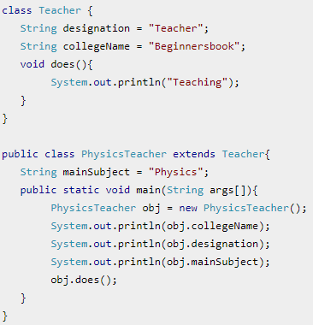
Inheritance
To inherit a class we use extends keyword.
Here class PhysicsTeacher is sub class and class Teacher is parent or base class. The class PhysicsTeacher is inheriting the properties and methods of Teacher class.
Since class PhysicsTeacher extends the designation and college properties and work() method from base class, we need not to declare these properties and method in sub class.
Here we have collegeName, designation and does() method which are common to all the teachers so we have declared them in the base class, this way the child classes like MathTeacher, MusicTeacher and PhysicsTeacher do not need to write this code and can be used directly from base class.

Slide 8
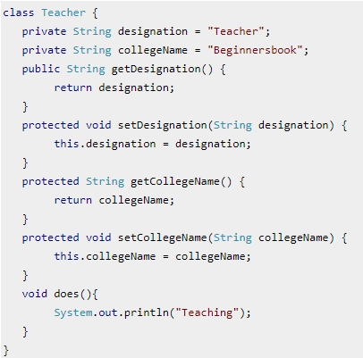
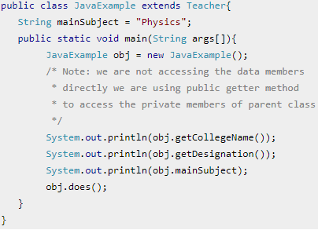
Inheritance
Based on the above example we can say that PhysicsTeacher IS-A Teacher.
This means that a child class has IS-A relationship with the parent class. This is inheritance is known as IS-A relationship between child and parent class
The derived class inherits all the members and methods that are declared as public or protected.
If the members or methods of super class are declared as private then the derived class cannot use them directly.
The private members can be accessed only in its own class.
Such private members can only be accessed using public or protected getter and setter methods of super class as shown in the example below.
Notes:
The important point to note in the above example is that the child class is able to access the private members of parent class through protected methods of parent class. When we make a instance variable(data member) or method protected, this means that they are accessible only in the class itself and in child class.

Slide 9
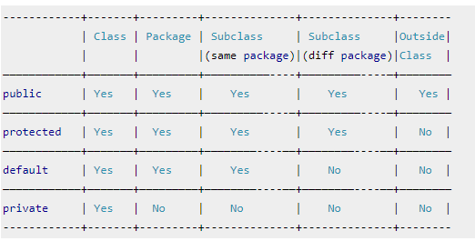
Inheritance – Remember the Access Modifiers

Slide 10
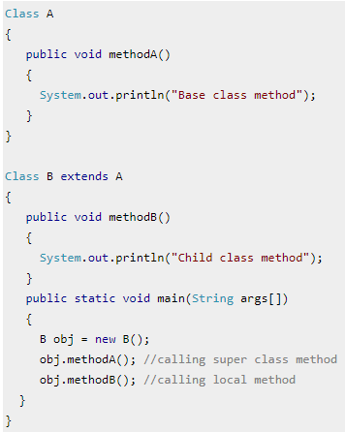
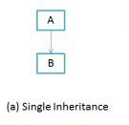
Inheritance - Types
Single Inheritance
When a class extends another one class only then we call it a single inheritance.
The below flow diagram shows that class B extends only one class which is A. Here A is a parent class of B and B would be a child class of A.

Slide 11
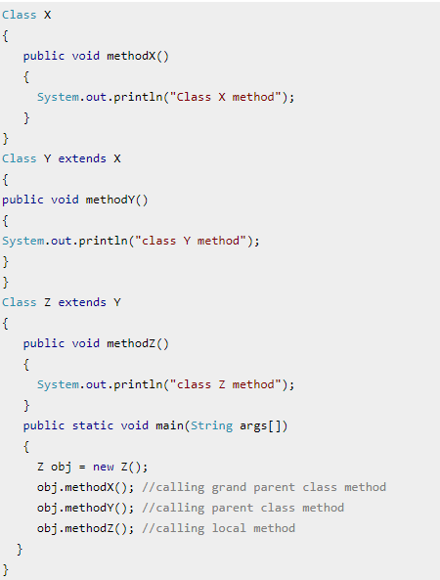
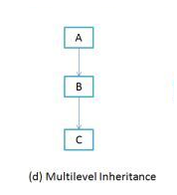
Inheritance - Types
Multi Level Inheritance
Multilevel inheritance refers to a mechanism in OO technology where one can inherit from a derived class, thereby making this derived class the base class for the new class.
As you can see in below flow diagram C is subclass or child class of B and B is a child class of A.

Slide 12
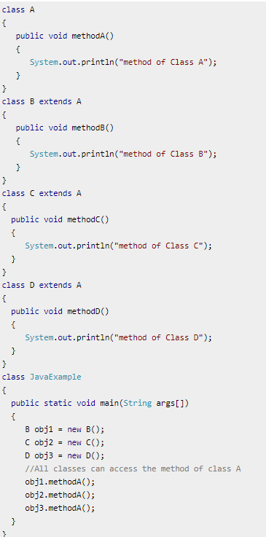
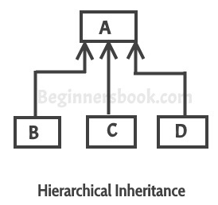
Inheritance - Types
Hierarchical Inheritance
When more than one classes inherit a same class then this is called hierarchical inheritance. For example class B, C and D extends a same class A.

Slide 13
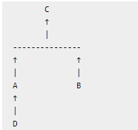
Inheritance - Types
In simple terms you can say that Hybrid inheritance is a combination of Single and Multiple inheritance.
A typical flow diagram would look like below.
A hybrid inheritance can be achieved in the java in a same way as multiple inheritance can be!! Using interfaces.
A hybrid inheritance is a combination of more than one types of inheritance. For example when class A and B extends class C & another class D extends class A then this is a hybrid inheritance, because it is a combination of single and hierarchical inheritance. Let me show you this diagrammatically:

Slide 14
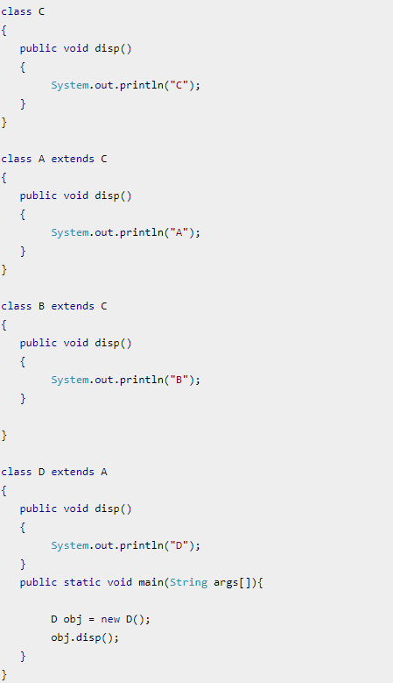
Inheritance - Types

Slide 15
Creating Sub Classes
Where there is a will there is an inheritance tax !!!

Slide 16
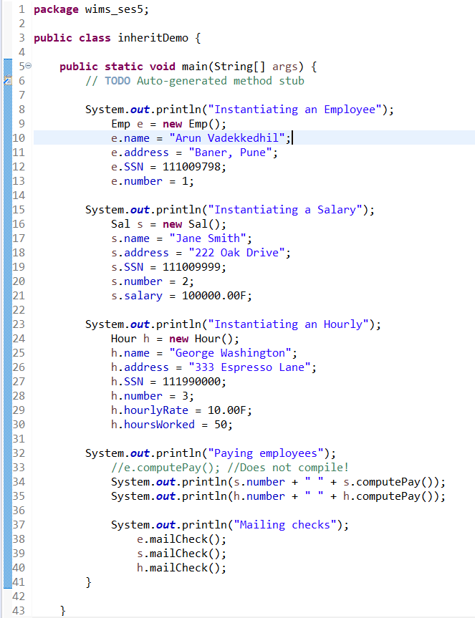
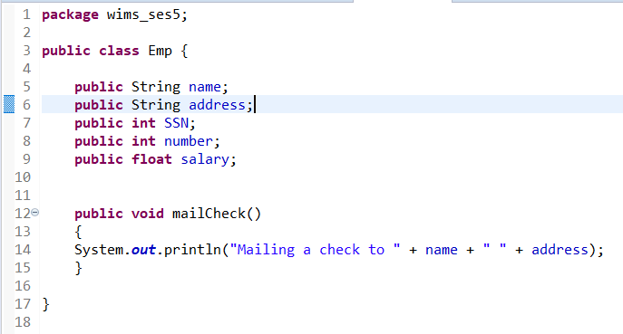
Sub Classes - Creation
Now that we have defined the Employee, Salary, and Hourly classes, let’s look at a program that instantiates and uses these classes.
The following Inherit-Demo program creates an Employee, Salary, and Hourly object.
Study the program carefully and try to determine its output.

Slide 17
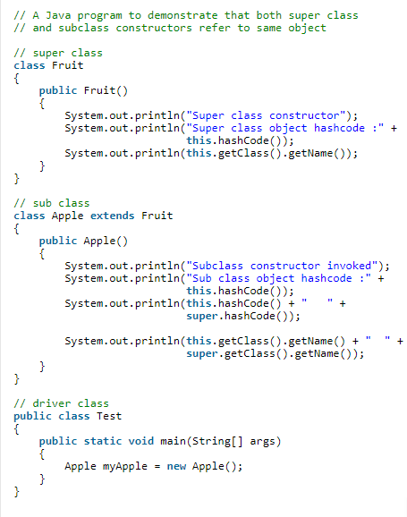
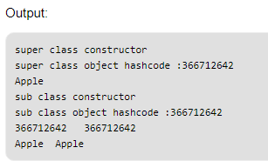
Sub Classes - Creation
When sub class object is created, super class object will NOT be created.
But if you try creating a sub class object, you will notice that super class constructor is also called.
But this doesn’t mean that super class object is created.
Notes:
Note: While a sub class is created, the java compiler implicitly calls the default super call constructor. This is to ensure that all properties and methods are made available in the sub class.
However, In case the super class has explicit constructors, then the first line in the sub class definition must be a call to invoke the upper class else will result in a compile time error.

Slide 18
Sub Classes – Fields & Methods Access
The inherited fields can be used directly, just like any other fields. You can declare new fields in the subclass that are not in the super class
You can declare a field in the subclass with the same name as the one in the super class, thus hiding it (not recommended).
A subclass does not inherit the private members of its parent class. However, if the super class has public or protected methods for accessing its private fields, these can also be used by the subclass.
The inherited methods can be used directly as they are. You can write a new instance method in the subclass that has the same signature as the one in the super class, thus overriding it.
You can write a new static method in the subclass that has the same signature as the one in the super class, thus hiding it.
You can declare new methods in the subclass that are not in the super class.

Slide 19
Sub Classes – Hiding
A class inherits all non-private static methods from its superclass.
Redefining an inherited static method in a class is known as method hiding.
The redefined static method in a subclass hides the static method of its superclass.
Redefining a non-static method in a class is called method overriding.
All rules about the redefined method (name, access level, return types, and exception) for method hiding are the same as for method overriding.
Variable hiding happens when we declare a property in a local scope that has the same name as the one we already have in the outer scope.
Before jumping to the examples, let’s briefly recap the possible variable scopes in Java. We can define them with the following categories:
local variables – declared in a piece of code such as methods, constructors, in any block of code with curly braces
instance variables – defined inside of a class and belong to the instance of the object
class or static variables – are declared in the class with the static keyword. They have a class level scope.

Slide 20
Sub Classes –Overriding
The ability of a subclass to override a method in its superclass allows a class to inherit from a superclass that is "close enough" in functionality and then supplement or modify the behaviour of that superclass.
Replacing a Superclass's Method Implementation
Sometimes, a subclass will want to replace entirely its superclass's implementation of a method.
Indeed, many super classes provide empty method implementation with the expectation that most, if not all, all subclasses will completely replace the superclass's implementation of the method.
One example of this is the run() method in the Thread class. The Thread class provides an empty implementation (the method does nothing) of the run() method because by definition the run() method is subclass dependent.
To completely replace a superclass's method implementation, simply name your method the same as the superclass method and provide the overriding method with the same signature as the overriden method.

Slide 21
Sub Classes –Overriding
Methods a Subclass Cannot Override
A subclass cannot override methods that are declared final in the superclass (by definition, final methods cannot be overriden).
If you attempt to override a final method, the compiler will display an error message similar to this one and refuse to compile the program:
FinalTest.java:7: Final methods can't be over ridden. Method void iamfinal() is final in class ClassWithFinalMethod.
void iamfinal() {
^
1 error
A subclass cannot override methods that are declared static in the superclass. In other words, a subclass cannot override a class method.
Methods a Subclass Must Override
Subclass must override methods that are declared abstract in the superclass, or the subclass must be abstract.

Slide 22
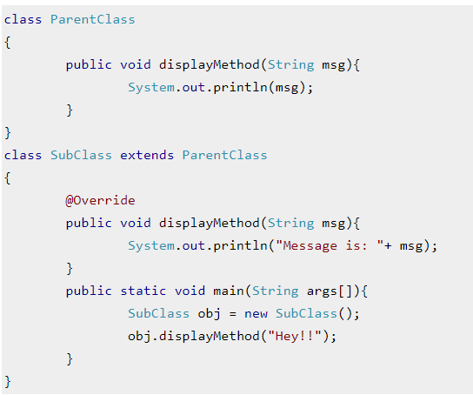
Sub Classes –Overriding
@Override annotation is used when we override a method in sub class.
Generally novice developers overlook this feature as it is not mandatory to use this annotation while overriding the method.
The above example we are overriding a method displaymethod() in the child class.
Even if we don’t use the @Override annotation, the program would still run fine without any issues, You would be wondering the why do we use this annotation

Slide 23
Sub Classes –Why we use @Override annotation
Using @Override annotation while overriding a method is considered as a best practice for coding in java because of the following two advantages:
If programmer makes any mistake such as wrong method name, wrong parameter types while overriding, you would get a compile time error.
  As by using this annotation you instruct compiler that you are overriding this method.
  If you don’t use the annotation then the sub class method would behave as a new method (not the overriding method) in sub class.

Slide 24
Sub Classes –Why we use @Override annotation
Using @Override annotation while overriding a method is considered as a best practice for coding in java because of the following two advantages:
2) It improves the readability of the code.
So if you change the signature of overridden method then all the sub classes that overrides the particular method would throw a compilation error, which would eventually help you to change the signature in the sub classes.
If you have lots of classes in your application then this annotation would really help you to identify the classes that require changes when you change the signature of a method.

Slide 25
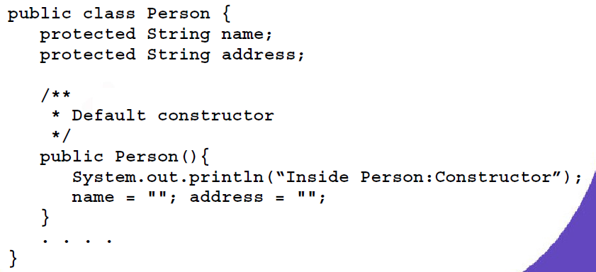
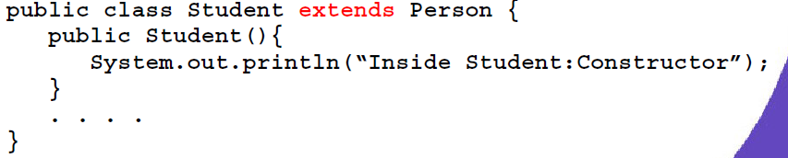
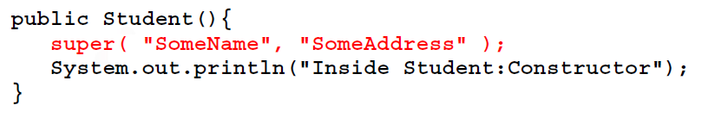
Sub Classes – Using Super()
A subclass can also explicitly call a constructor of its immediate super class.
This is done by using the super constructor call.
A super constructor call in the constructor of a subclass will result in the execution of relevant constructor from the super class, based on the arguments passed.
Few things to remember when using the super constructor call:
– The super() call must occur as the first statement in a Constructor
– The super() call can only be used in a constructor (not in ordinary methods)

Slide 26
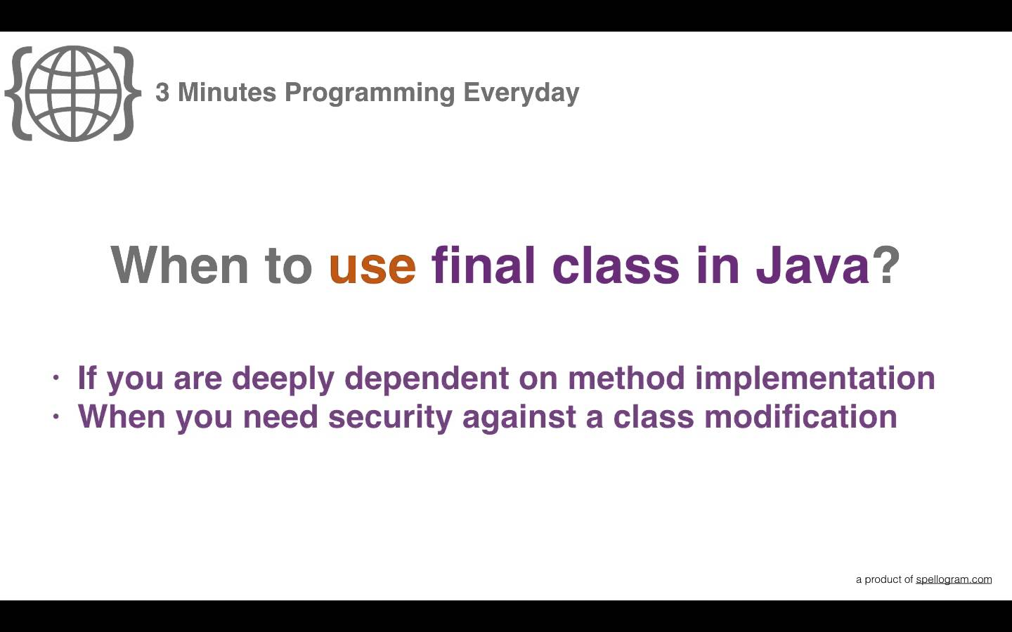
FINAL
Not any tournament, but a non access modifier

Slide 27
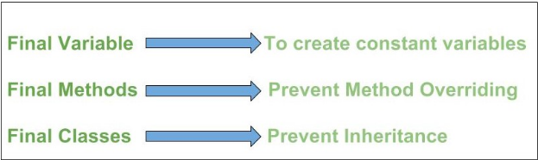
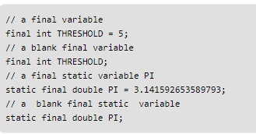
Finally – Using final keyword
final keyword is used in different contexts.
First of all, final is a non-access modifier applicable only to a variable, a method or a class.
When a variable is declared with final keyword, its value can’t be modified, essentially, a constant.
This also means that you must initialize a final variable.
If the final variable is a reference, this means that the variable cannot be re-bound to reference another object, but internal state of the object pointed by that reference variable can be changed i.e. you can add or remove elements from final array or final collection.
It is good practice to represent final variables in all uppercase, using underscore to separate words.

Slide 28
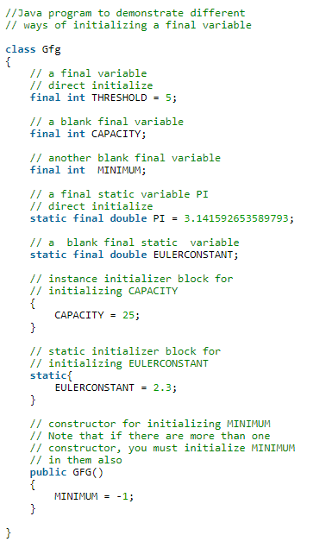
Finally – Using final keyword
Initializing a final variable :
We must initialize a final variable, otherwise compiler will throw compile-time error.
A final variable can only be initialized once, either via an initializer or an assignment statement. There are three ways to initialize a final variable :
  You can initialize a final variable when it is declared.
  This approach is the most common.
  A final variable is called blank final variable, if it is not initialized while declaration.
Below are the two ways to initialize a blank final variable.
  A blank final variable can be initialized inside instance-initializer block or inside constructor.
  If you have more than one constructor in your class then it must be initialized in all of them, otherwise compile time error will be thrown.
A blank final static variable can be initialized inside static block.

Slide 29

Finally – Using final keyword
When to use a final variable :
The only difference between a normal variable and a final variable is that we can re-assign value to a normal variable but we cannot change the value of a final variable once assigned. Hence final variables must be used only for the values that we want to remain constant throughout the execution of program.
Reference final variable :
When a final variable is a reference to an object, then this final variable is called reference final variable. For example, a final StringBuffer variable looks like
As you know that a final variable cannot be re-assign. But in case of a reference final variable, internal state of the object pointed by that reference variable can be changed. Note that this is not re-assigning. This property of final is called non-transitivity.

Slide 30
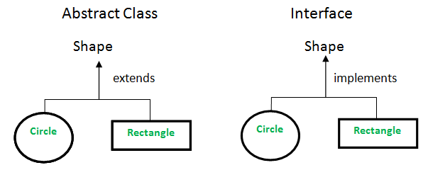
Abstract Classes
It’s Different

Slide 31
Abstraction
One of the most fundamental concept of OOPs is Abstraction.
Abstraction is a process where you show only “relevant” data and “hide” unnecessary details of an object from the user.
For example, when you login to your Amazon account online, you enter your user_id and password and press login, what happens when you press login, how the input data sent to amazon server, how it gets verified is all abstracted away from the you.
Another example of abstraction:
A car in itself is a well-defined object, which is composed of several other smaller objects like a gearing system, steering mechanism, engine, which are again have their own subsystems.
But for humans car is a one single object, which can be managed by the help of its subsystems, even if their inner details are unknown.

Slide 32
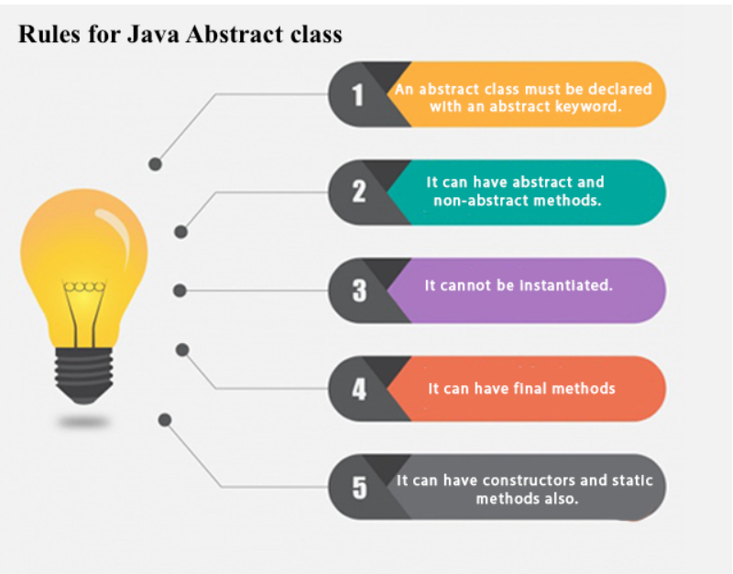
Abstraction

Slide 33
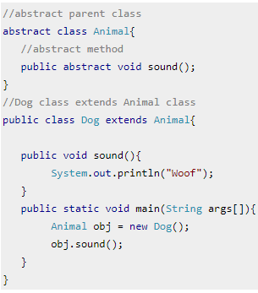
Abstract Classes
A class that is declared using “abstract” keyword is known as abstract class.
It can have abstract methods(methods without body) as well as concrete methods (regular methods with body).
A normal class(non-abstract class) cannot have abstract methods.
In this section we will learn what is a abstract class, why we use it and what are the rules that we must remember while working with it in Java.
An abstract class can not be instantiated, which means you are not allowed to create an object of it.
The purpose of an abstract class is to leave the implementation of details to the deriving classes.
The above approach will provide more flexibility when the sub classes inherit base class.
Do you know? Since abstract class allows concrete methods as well, it does not provide 100% abstraction. You can say that it provides partial abstraction.

Slide 34
Abstract Classes
Note 1: As we seen in the above example, there are cases when it is difficult or often unnecessary to implement all the methods in parent class.
In these cases, we can declare the parent class as abstract, which makes it a special class which is not complete on its own.
A class derived from the abstract class must implement all those methods that are declared as abstract in the parent class.
Note 2: Abstract class cannot be instantiated which means you cannot create the object of it.
To use this class, you need to create another class that extends this this class and provides the implementation of abstract methods, then you can use the object of that child class to call non-abstract methods of parent class as well as implemented methods(those that were abstract in parent but implemented in child class).
Note 3: If a child does not implement all the abstract methods of abstract parent class, then the child class must need to be declared abstract as well.

Slide 35

Questions ?
You can contact me @
avadekkedhil@wilp.bits-pilani.ac.in
9881300394

